Slide 1
Arduino UNO
Lafe Spietz

Slide 2
Arduino
Open Source
Not a company
A wide range of products sold by many vendors around the world
The Arduino UNO is one of the most popular and easiest to use of the boards
Can be programmed on Windows, Mac and Linux using the Arduino IDE
Programmed in a c-like language based on Processing(a language designed for artists)

Slide 3
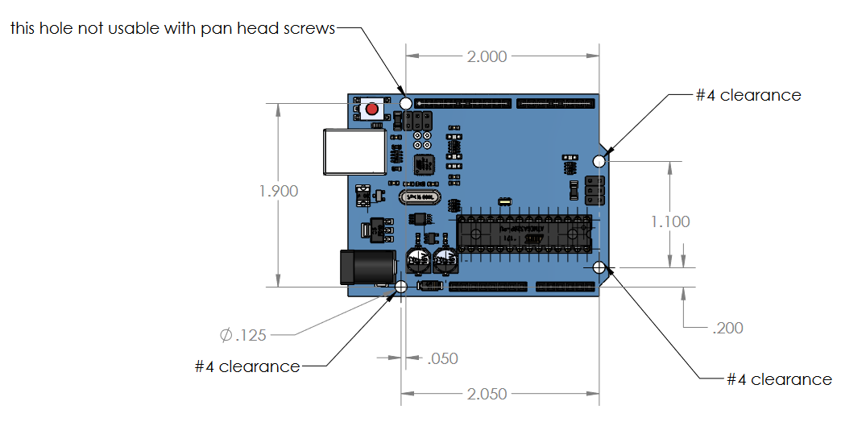
Arduino UNO

Slide 4
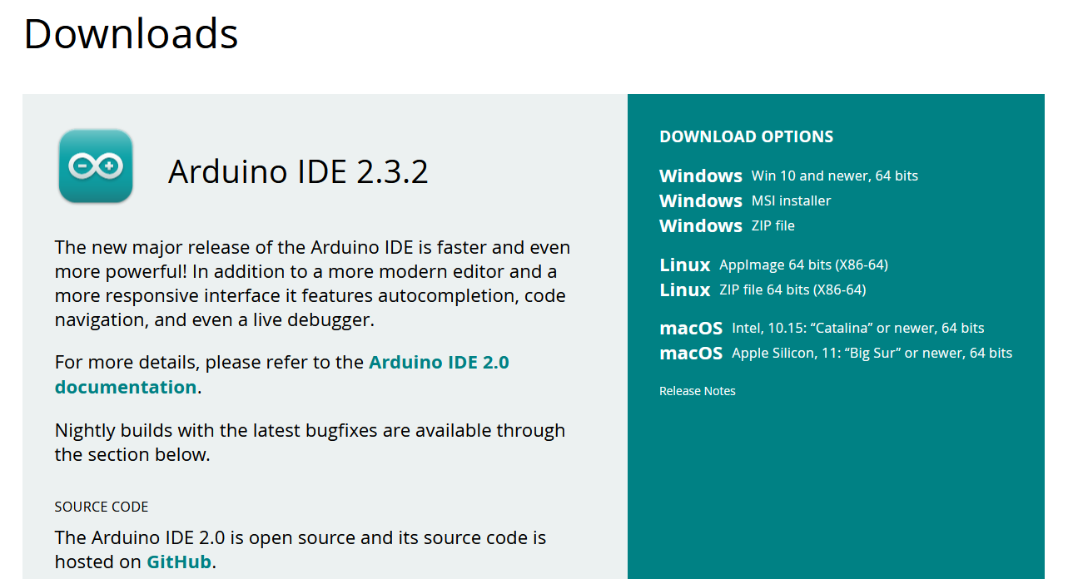
https://www.arduino.cc/en/software

Slide 5
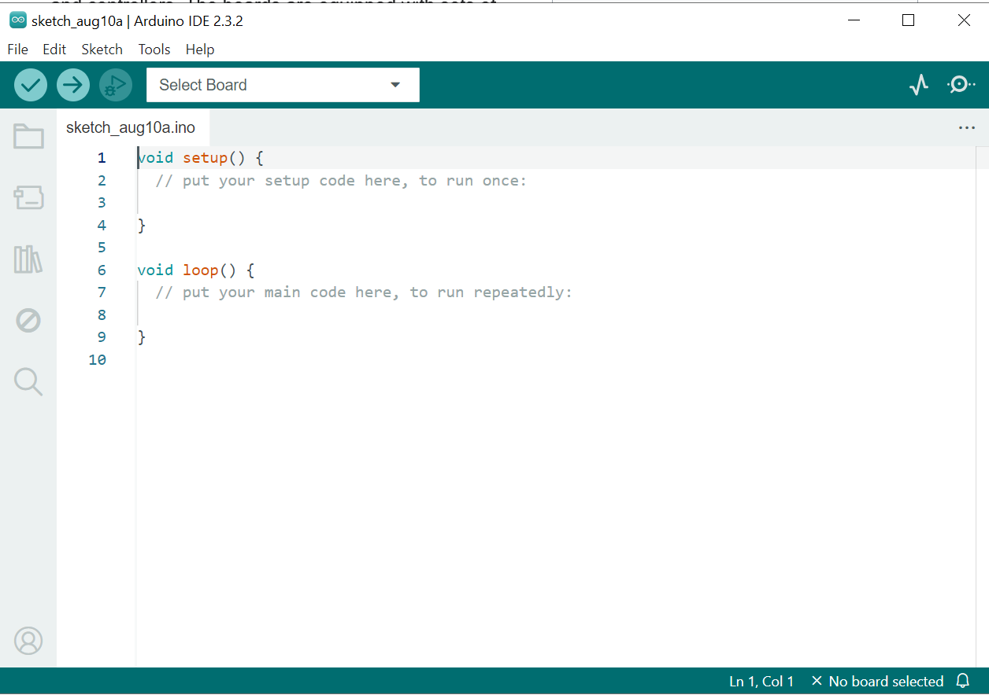

Slide 6
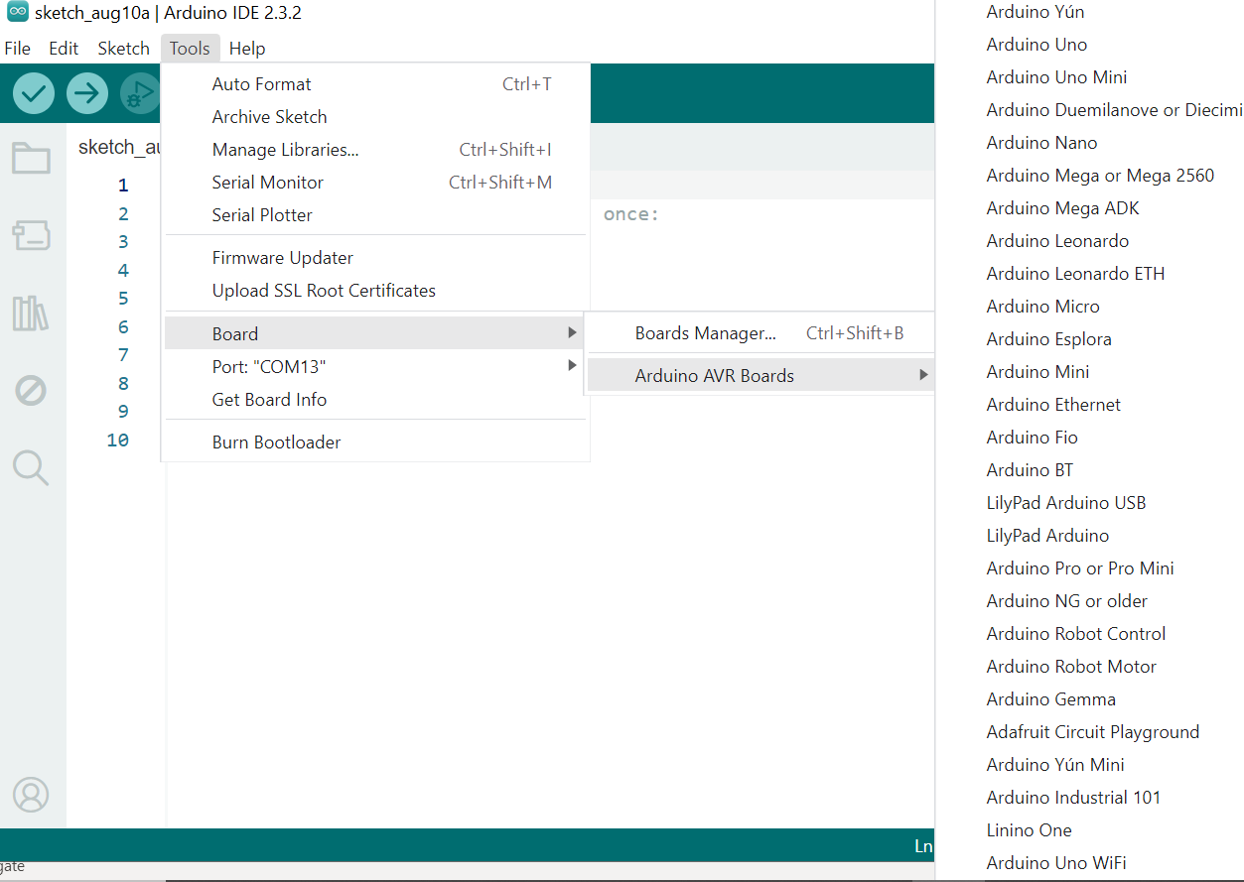
Select the UNO

Slide 7
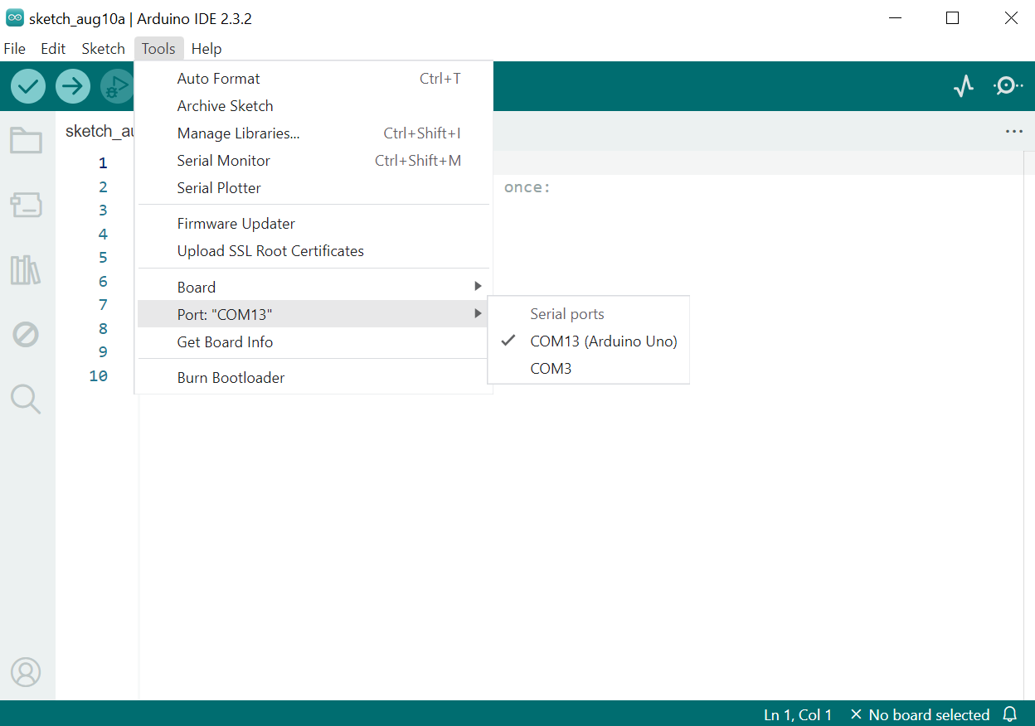

Slide 8
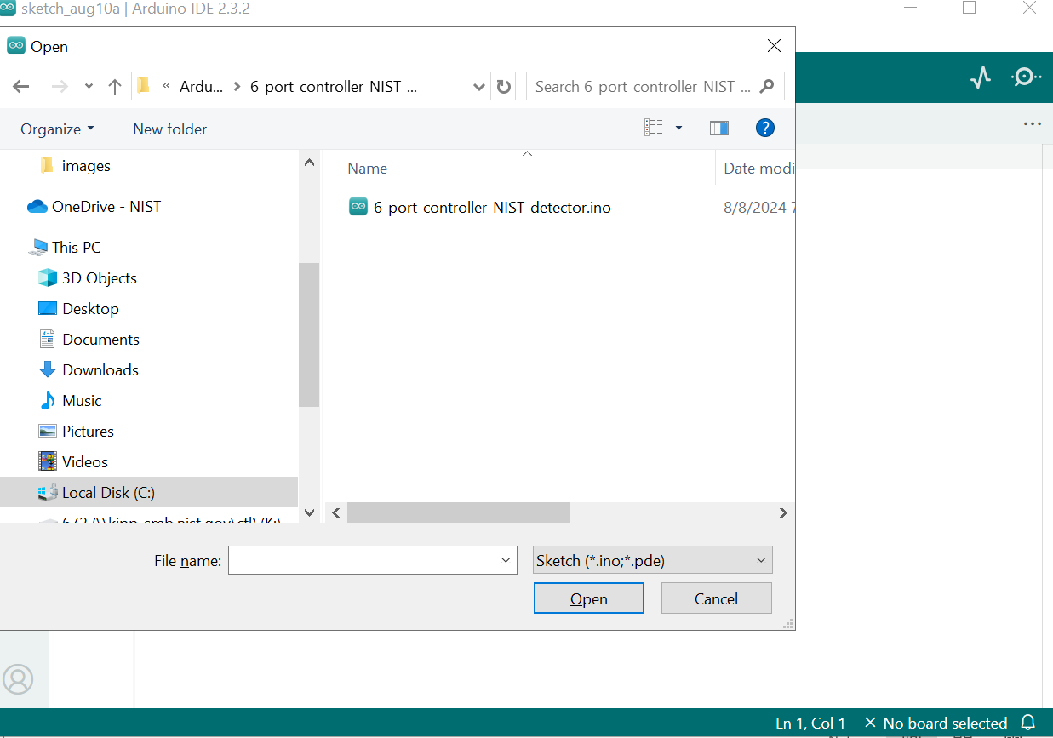

Slide 9
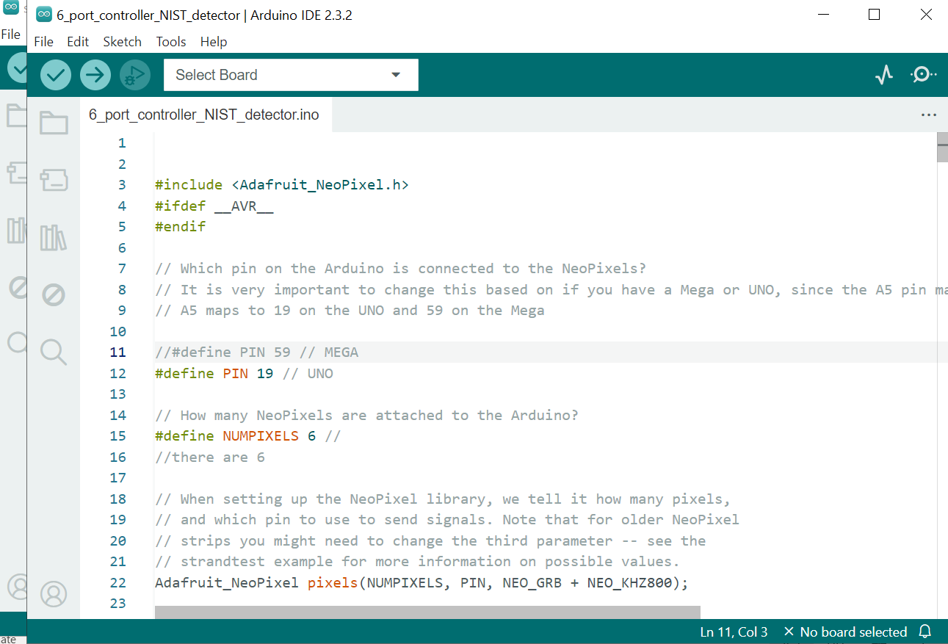

Slide 10
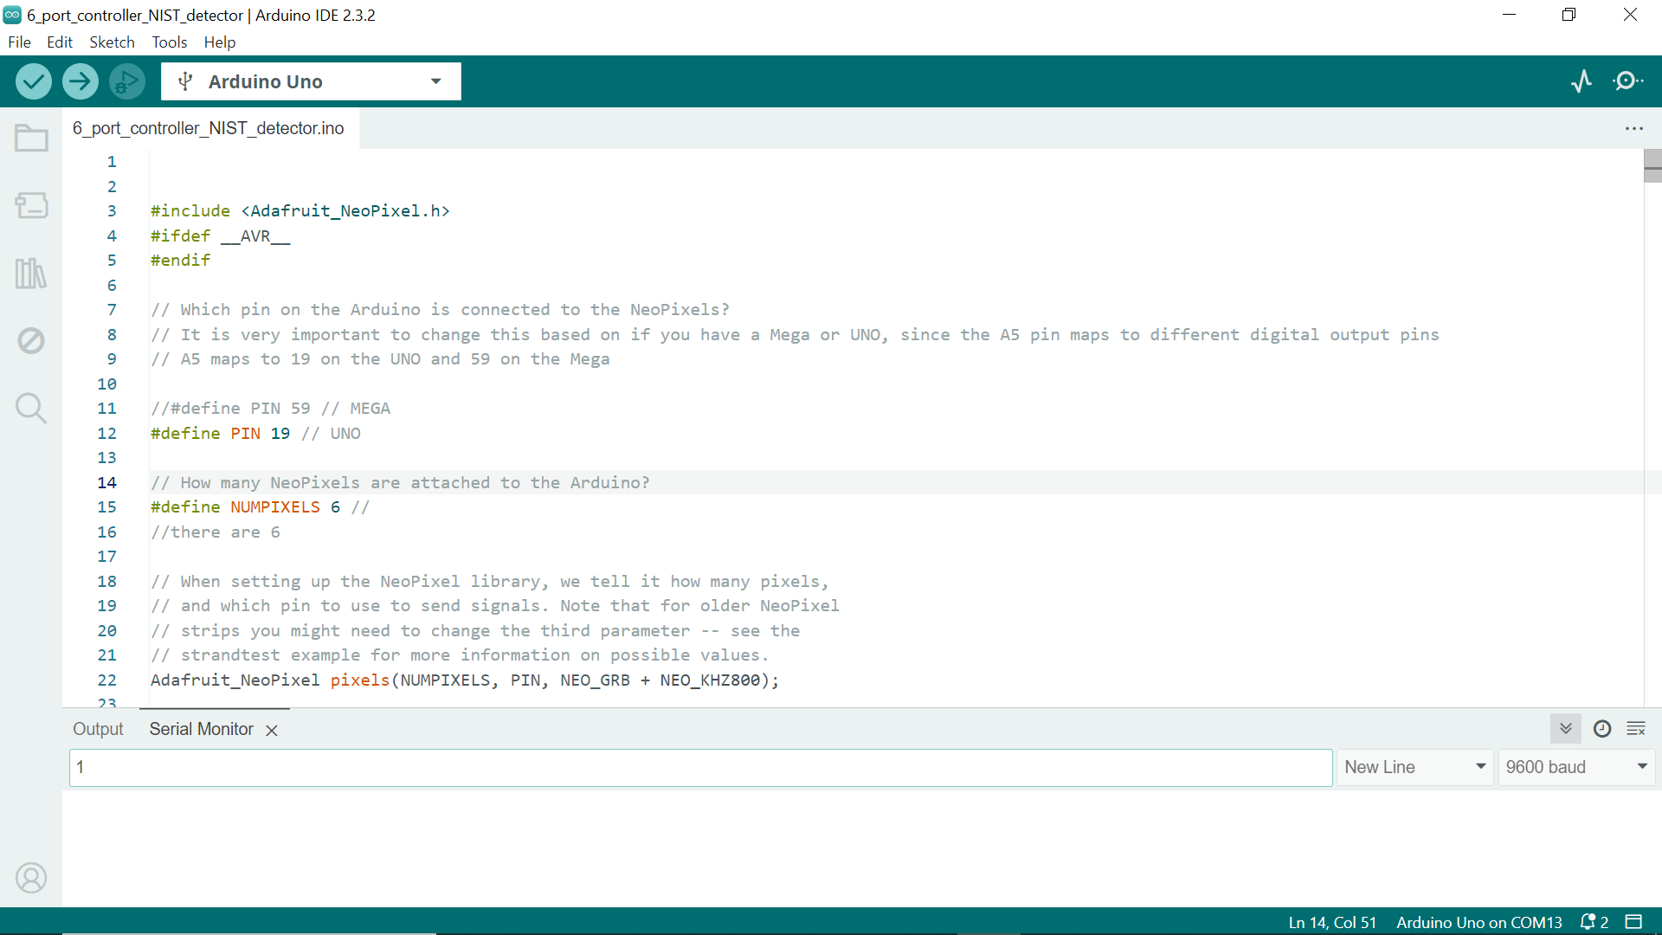

Slide 11
Send control characters down serial

